Slide 1

Arbitrage Under Power Mean Reversion
Siqi Jonathan Fan (sf3402)
Ji Wu (jw5971)
Titash Ghoshal (tg1901)
Guided by Dr. Daniel Totouom-Tangho

Slide 2

Agenda
Introduction
Motivation
Main questions
Model and strategy
Price process & utility function
Position & wealth
The optimal strategy
Position management
Empirical Analysis
Simulation
Sensitivity analysis
ETF pair trading
Conclusion and Challenge
Improvement

Slide 3
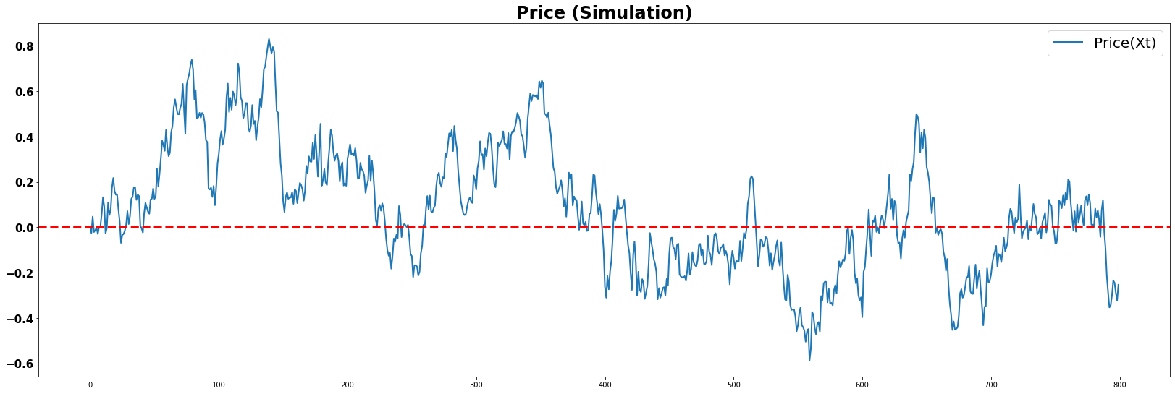
In this project, we consider a problem where the asset price is driven by a mean-reverting process.
Motivation
Consider, for example, we are trading the spreads between two cointegrated assets.
The spread between these two assets follows a mean-reverting process (OU process), so we can arbitrage when the spread deviates from its long-term average.
Faced with a mean-reverting process, a trader would typically take a long position when the asset is below its long-term mean and a short position when the asset is above the long-term mean.
The question is in the size of the position and how the position should be optimally managed as the price and wealth change and time passes by.

Slide 4
Besides the quantitative result, there are several questions to answer about the optimal strategy.
Main Questions
1
When and how aggressively should one open the position？
2
When should one cut a losing position?
3
What is the effect of parameters on the optimal strategy?
4
In addition to simulation result, does this strategy work well using empirical data?

Slide 5
Agenda
Introduction
Motivation
Main questions
Model and strategy
Price process & utility function
Position & wealth
The optimal strategy
Position management
Empirical Analysis
Simulation
Sensitivity analysis
ETF pair trading
Conclusion and Challenge
Improvement

Slide 6
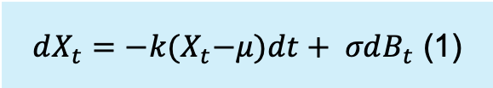
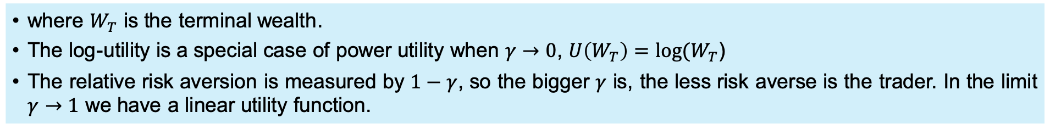

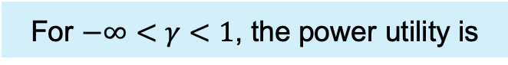
We assume the spread between 2 assets follows the Ornstein-Uhlenbeck process and utility function is power utility function.
Price Process and Utility Function
The Ornstein-Uhlenbeck process
$dX_{t}=−k{(X}_{t}−μ)dt+ σdB_{t}$ (1)
where $μ$ is the long term mean of the price process, $B_{t}$ is a Brownian motion, k measures the speed of the mean-reversion and $σ$ measures the strength of the noise component.
For $−∞<γ<1$, the power utility is
$U=U\left(W_{T}\right)= \frac{1}{γ}W_{T}^{γ}$ (2)
where $W_{T}$ is the terminal wealth.
The log-utility is a special case of power utility when $γ→0$, $U\left(W_{T}\right)=log⁡(W_{T}$)
The relative risk aversion is measured by $1−γ$, so the bigger $γ$ is, the less risk averse is the trader. In the limit $γ→1$ we have a linear utility function.

Slide 7

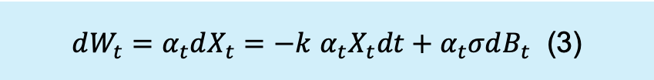
Suppose a traded asset follows an Ornstein-Uhlenbeck process, then we can set $X_{t}$ as the spread between the price and its long term mean.
Position and Wealth
Let $α_{t}$ be a trader’s position at time t, i.e. the number of units of the asset held. Assuming zero interest rate and no market frictions, the wealth dynamics is given by:
$dW_{t}=α_{t}dX_{t}=−k$ $α_{t}X_{t}dt+α_{t}σdB_{t}$ (3)
The utility function (2) is defined over the terminal wealth $W_{T}$. The value function $J(W_{t}$, $X_{t},t)$ is the expectation of the terminal utility conditional available at time t:
$J(W_{t}$, $X_{t},t)= \sup_{α}E_{t}\frac{1}{γ}W_{T}^{γ}$ (4)

Slide 8
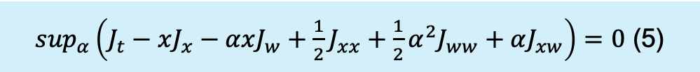


We need to find the optimal position $α^{∗}(W_{t}$, $X_{t},t)$ and the value function $J(W_{t}$, $X_{t},t$) as explicit functions of wealth $W_{t}$, price $X_{t}$ and time $t$
The Optimal Strategy
We can first use Hamilton-Jacobi-Bellman equation:
$\sup_{α}\left(J_{t}−xJ_{x}−αxJ_{w}+\frac{1}{2}J_{xx}+\frac{1}{2}α^{2}J_{ww}+αJ_{xw}\right)=0$ (5)
Then we take the first order on position $α^{∗}$:
$α^{∗}\left(w,x,t\right)=x\frac{J_{w}}{J_{ww}}−\frac{J_{xw}}{J_{ww}}$ (6)
Substituting (6) into the HJB equation for the value function, we can obtain the non-linear PDE:
$J_{t}+\frac{1}{2}J_{xx}−xJ_{x}−\frac{1}{2}J_{ww}{\left(x\frac{J_{w}}{J_{ww}}−\frac{J_{xw}}{J_{ww}}\right)}^{2}=0$ (7)

Slide 9




We need to find the optimal position $α^{∗}(W_{t}$, $X_{t},t)$ and the value function $J(W_{t}$, $X_{t},t$) as explicit functions of wealth $W_{t}$, price $X_{t}$ and time $t$
The Optimal Strategy
Let $τ=T − t$, which is the time left for trading and define the constant $ν$ and time functions $C\left(τ\right),C^{′}\left(τ\right), D(τ)$ by
$ν= \frac{1}{\sqrt{1−γ}}$ (8)
$C\left(τ\right)=coshντ+⁡νsinh⁡(ντ)$ (9)
$C^{′}\left(τ\right)= \frac{dC\left(τ\right)}{dτ}=ν\sinh\left(ντ\right)+ ν^{2}cosh⁡(ντ$) (10)
$D\left(τ\right)= \frac{C^{′}\left(τ\right)}{C\left(τ\right)}$ (11)
The optimal position is
$α_{t}^{∗}=−W_{t}X_{t}D(τ)$ (12)
The value function is
$J(W_{t}$, $X_{t},t$) = $\frac{1}{γ}w^{γ}\sqrt{e^{τ}{C\left(τ\right)}^{γ−1}} exp⁡(\frac{x^{2}}{2}\left(1+\left(γ−1\right)D\left(τ\right)\right)$ (13)

Slide 10
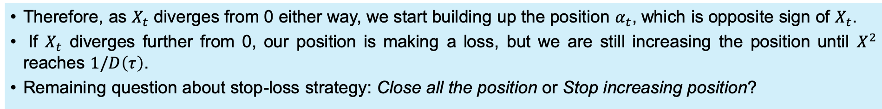
We know the price will sooner or later revert to the “correct value”, but the risk is that the position losses may become unbearable before the reversion happens. Thus, we need to know when to close the position.
Position Management
We can derive the diffusion term of $dα_{t}$ from (12) and the covariance of$d_{α}$ and $dX$:
$Cov\left(d_{α},dX\right)=−D\left(τ\right)\left(W_{t}+α_{t}X_{t}\right)=W_{t}D\left(τ\right)(−1+X_{t}^{2}D\left(τ\right)$) (14)
(14) is negative whenever $\left|X\right|≤\sqrt{1/D\left(τ\right)}$ (15)
Therefore, as $X_{t}$ diverges from 0 either way, we start building up the position $α_{t}$, which is opposite sign of $X_{t}$.
If $X_{t}$ diverges further from 0, our position is making a loss, but we are still increasing the position until $X^{2}$ reaches $1/D\left(τ\right)$.
Remaining question about stop-loss strategy: Close all the position or Stop increasing position?

Slide 11

Agenda
Introduction
Motivation
Main questions
Model and strategy
Price process & utility function
Position & wealth
The optimal strategy
Position management
Empirical Analysis
Simulation
Sensitivity analysis
ETF pair trading
Conclusion and Challenge
Improvement

Slide 12
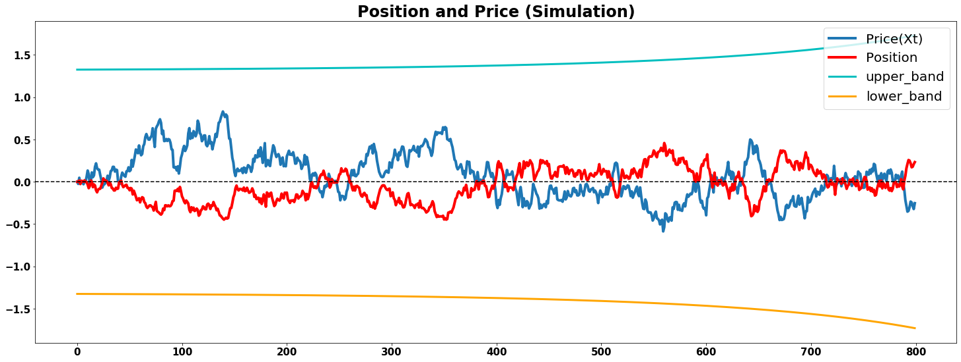
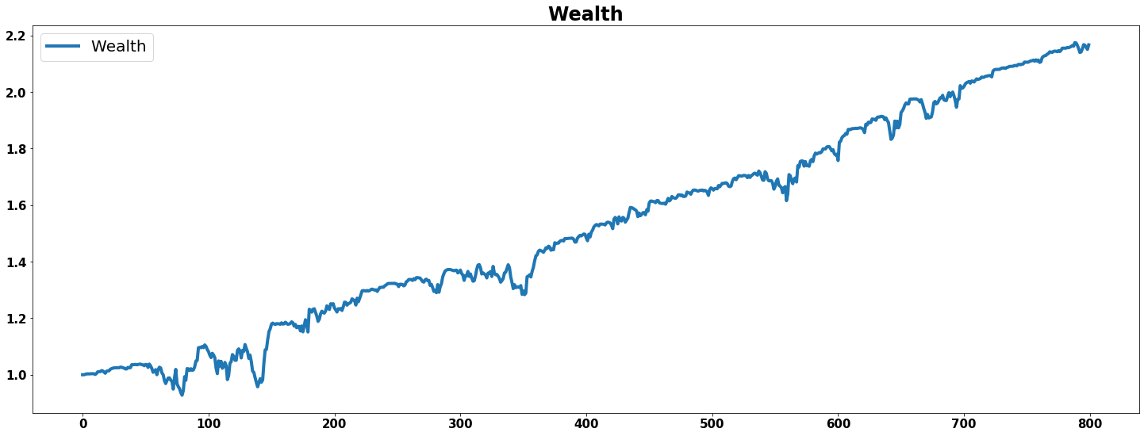
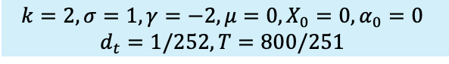
In this section, we analyze the behavior of optimal strategy under simulation condition. Two stop loss strategies are used here – close all positions and stop increasing position.
Simulation ($σ$ = 1)
$$k=2, σ=1,γ=−2, μ=0,X_{0}=0,α_{0}=0$$
$$d_{t}=1/252,T=800/251$$

Slide 13
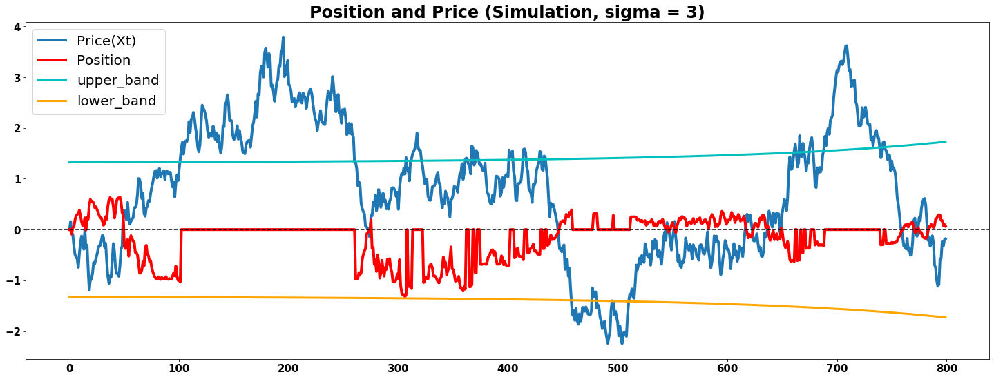
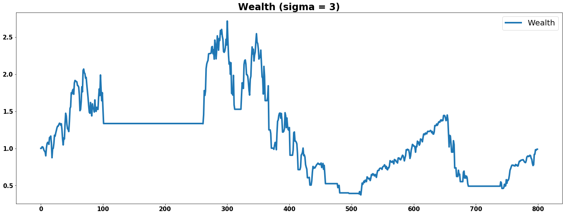
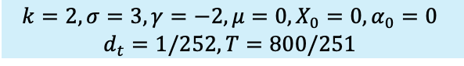
In this section, we analyze the behavior of optimal strategy under simulation condition. The stop loss strategy here is closing all positions ($α_{t}=0$)
Simulation ($σ$ = 3, stop-loss 1)
$$k=2, σ=3,γ=−2, μ=0,X_{0}=0,α_{0}=0$$
$$d_{t}=1/252,T=800/251$$

Slide 14
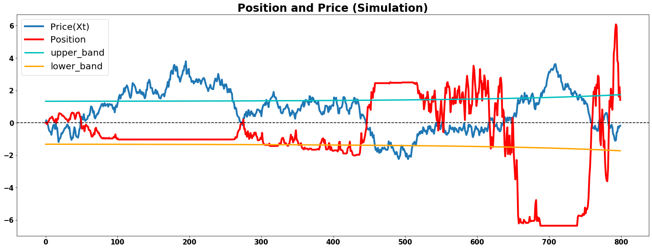
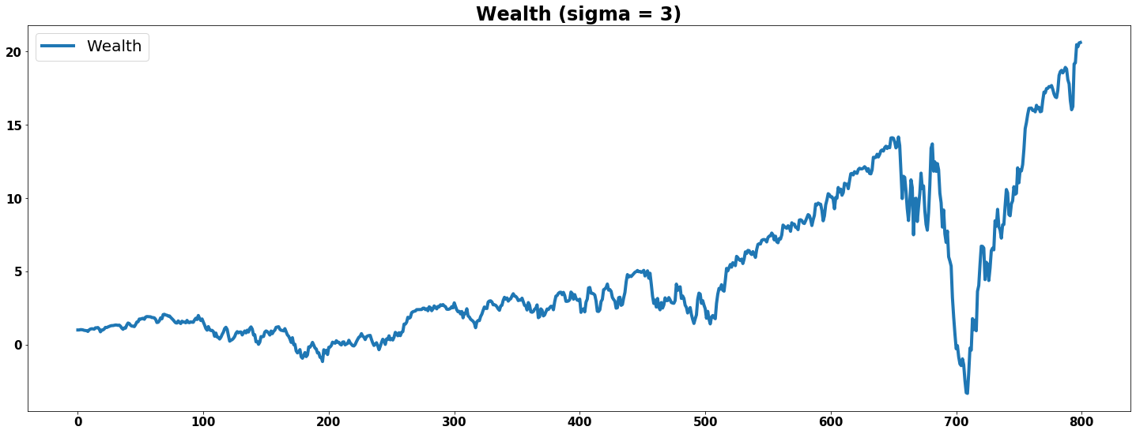
In this section, we analyze the behavior of optimal strategy under simulation condition. The stop loss strategy here is keeping the position unchanged ($α_{t}=α_{t−1}$)
Simulation ($σ$ = 3, stop-loss 2)
$$k=2, σ=3,γ=−2, μ=0,X_{0}=0,α_{0}=0$$
$$d_{t}=1/252,T=800/251$$

Slide 15
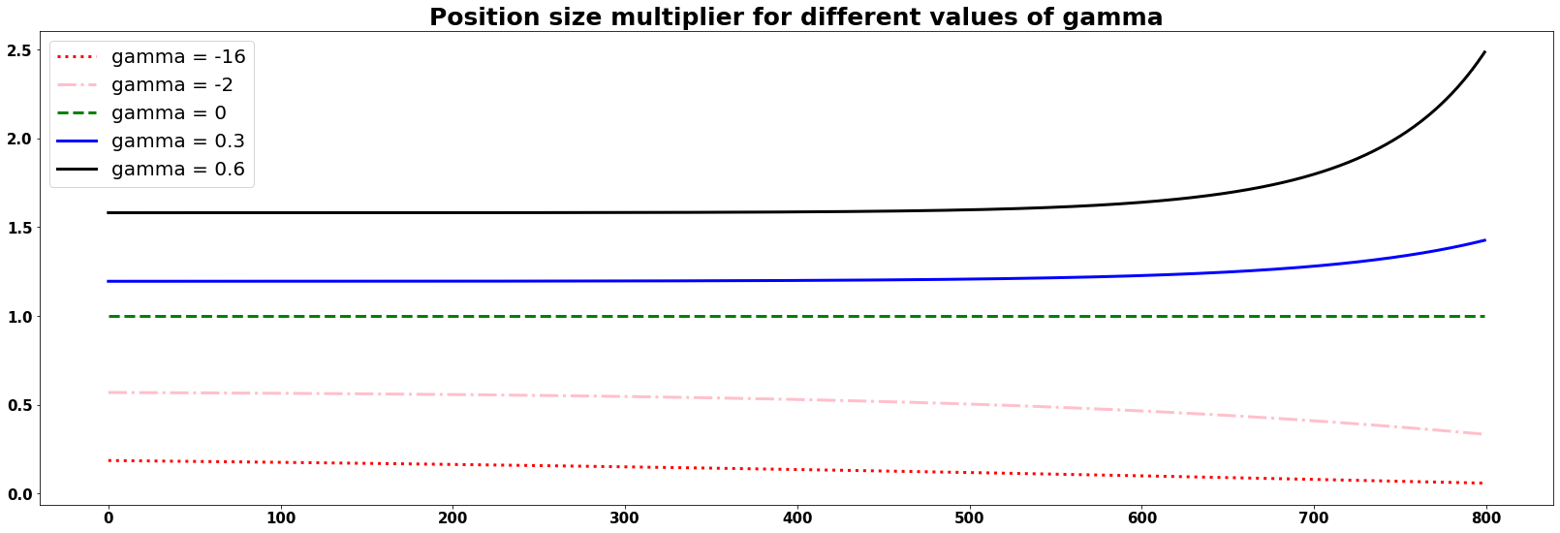
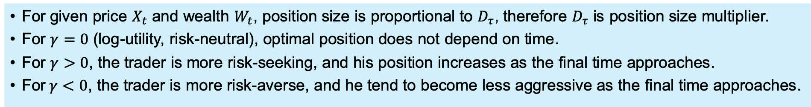
In this section, we analyze the effect of parameters on optimal strategy. First, we shows the graph of $D_{τ}$ for different values of $γ$.
Sensitivity Analysis
For given price $X_{t}$ and wealth $W_{t}$, position size is proportional to $D_{τ}$, therefore $D_{τ}$ is position size multiplier.
For $γ=0$ (log-utility, risk-neutral), optimal position does not depend on time.
For $γ>0$, the trader is more risk-seeking, and his position increases as the final time approaches.
For$γ<0$, the trader is more risk-averse, and he tend to become less aggressive as the final time approaches.

Slide 16
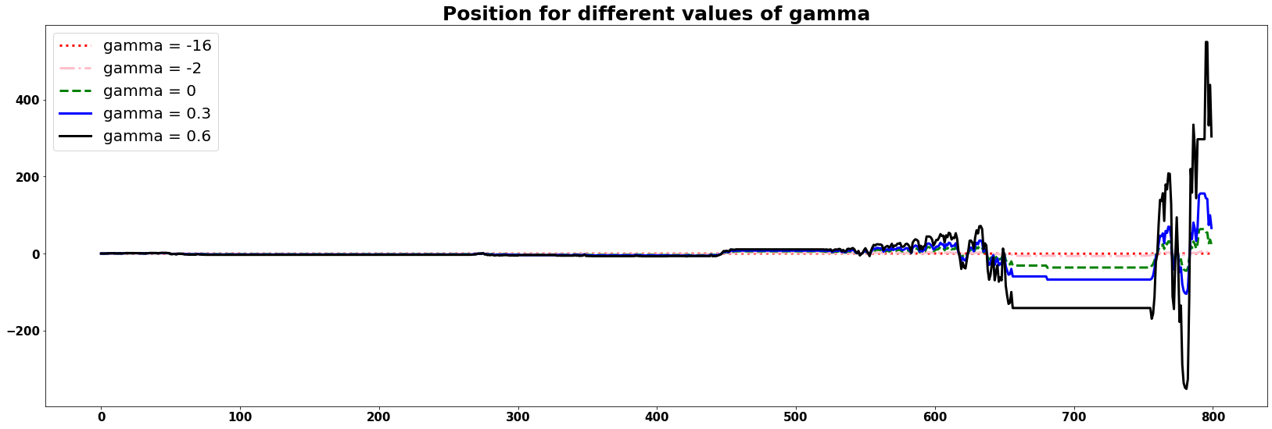
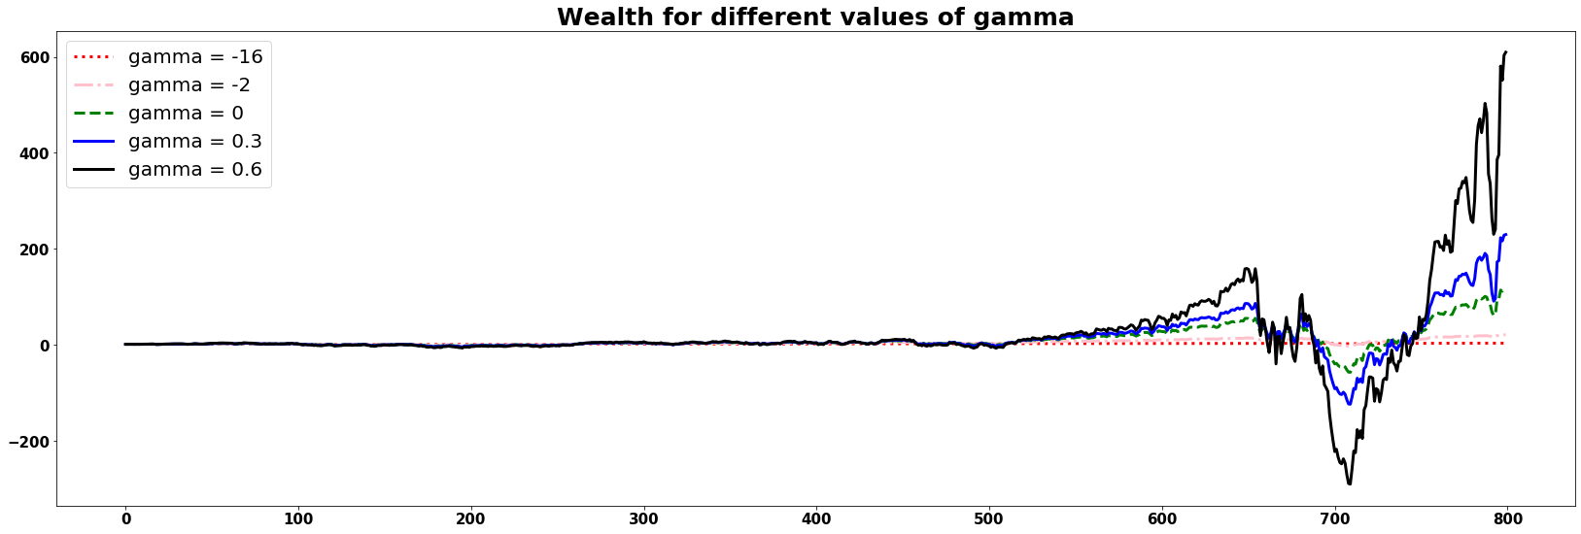
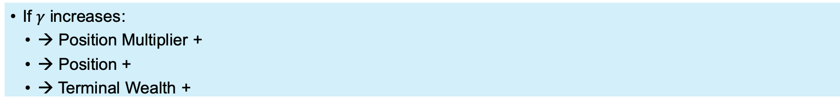
Second, we shows the graph of $α_{t}$ and $W_{t}$for different values of $γ$.
Sensitivity Analysis
If $γ$ increases:
→ Position Multiplier +
→ Position +
→ Terminal Wealth +

Slide 17
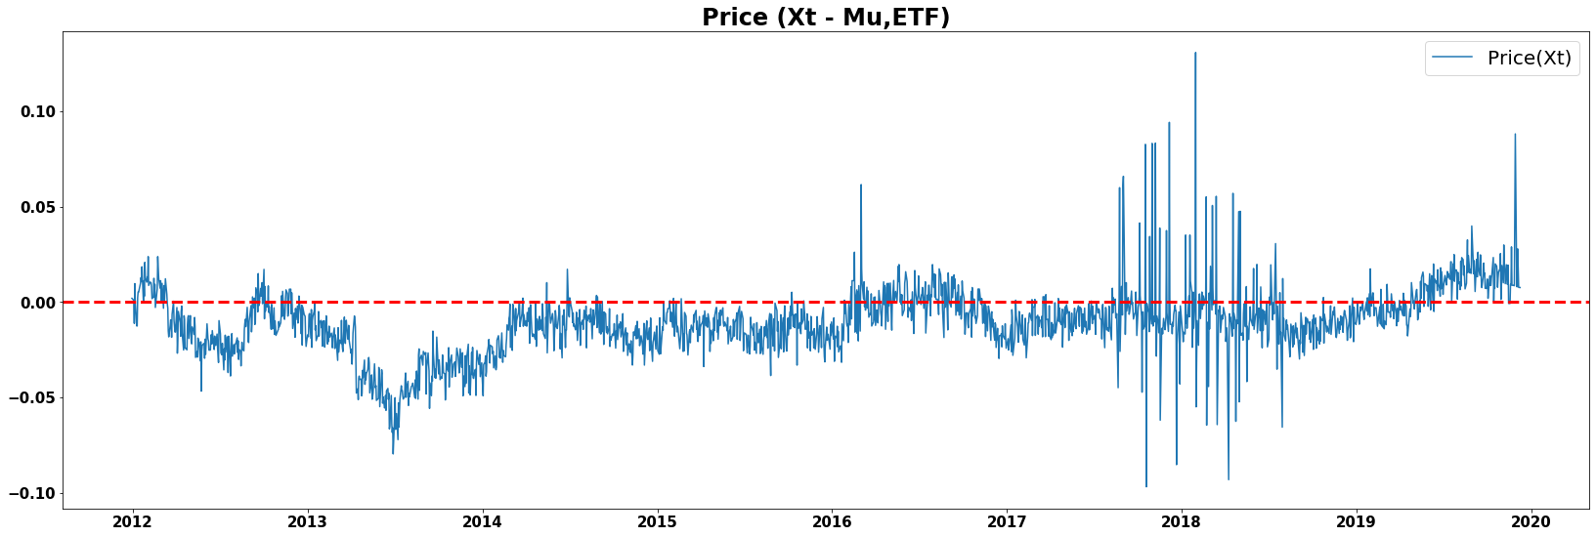
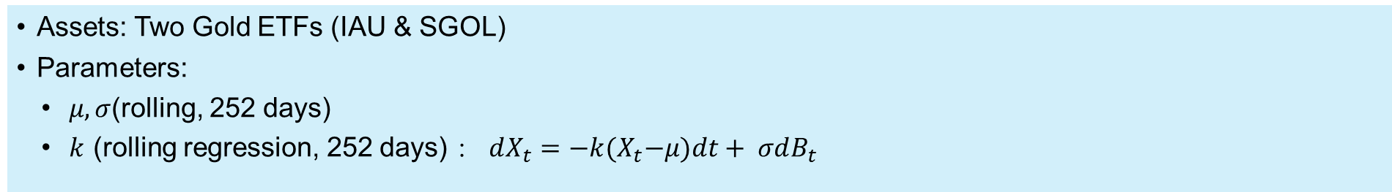
In this section, we analyze the behavior of optimal strategy using empirical data.
ETF Pair Trading
Assets: Two Gold ETFs (IAU & SGOL)
Parameters:
$μ, σ$(rolling, 252 days)
$k$ (rolling regression, 252 days) ：$dX_{t}=−k{(X}_{t}−μ)dt+ σdB_{t}$

Slide 18
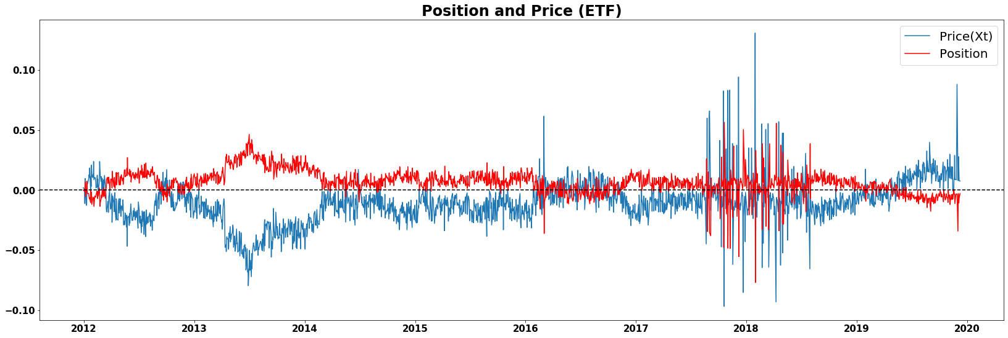
In this section, we analyze the behavior of optimal strategy using empirical data.
ETF Pair Trading
Assets: Two Gold ETFs (IAU & SGOL)
Parameters:
$μ,σ$(rolling, 252 days)
$k$ (rolling regression, 252 days) ：$dX_{t}=−k{(X}_{t}−μ)dt+ σdB_{t}$

Slide 19
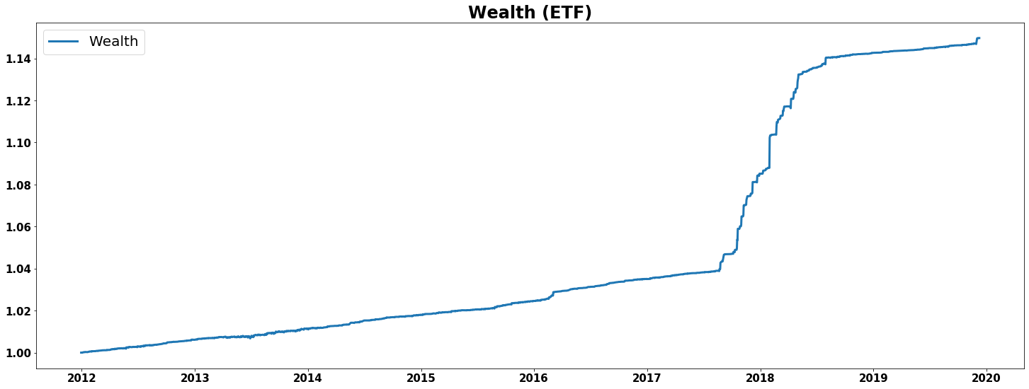
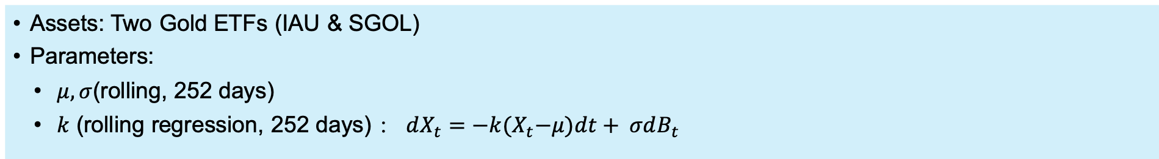
In this section, we analyze the behavior of optimal strategy using empirical data.
ETF Pair Trading
Assets: Two Gold ETFs (IAU & SGOL), 1/1/2010 - 12/6/2019
Parameters: $μ,σ$ (rolling, 252 days), $k$ (rolling regression, 252 days)
Assets: Two Gold ETFs (IAU & SGOL)
Parameters:
$μ,σ$(rolling, 252 days)
$k$ (rolling regression, 252 days) ：$dX_{t}=−k{(X}_{t}−μ)dt+ σdB_{t}$

Slide 20
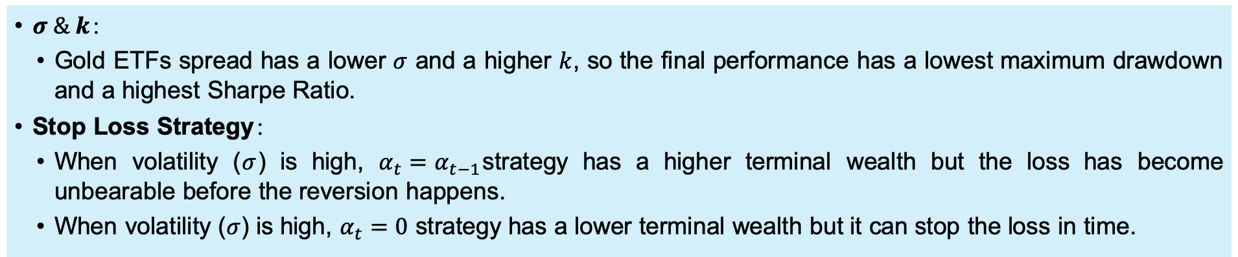
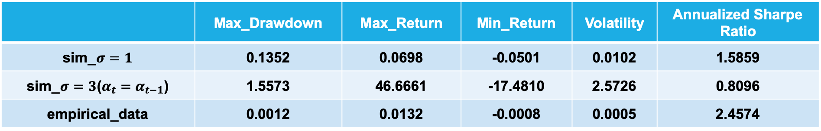
In this section, we summarize the performance metrics of our strategy using simulation and empirical data.
Performance Metrics
Assets: Two Gold ETFs (IAU & SGOL), 1/1/2010 - 12/6/2019
Parameters: $μ,σ$ (rolling, 252 days), $k$ (rolling regression, 252 days)
 | Max_Drawdown | Max_Return | Min_Return | Volatility | Annualized Sharpe Ratio
sim_$σ=1$ | 0.1352 | 0.0698 | -0.0501 | 0.0102 | 1.5859
sim_$σ=3$($α_{t}=α_{t−1}$) | 1.5573 | 46.6661 | -17.4810 | 2.5726 | 0.8096
empirical_data | 0.0012 | 0.0132 | -0.0008 | 0.0005 | 2.4574
$σ \& k$：
Gold ETFs spread has a lower $σ$ and a higher $k$, so the final performance has a lowest maximum drawdown and a highest Sharpe Ratio.
Stop Loss Strategy：
When volatility ($σ$) is high, $α_{t}=α_{t−1}$strategy has a higher terminal wealth but the loss has become unbearable before the reversion happens.
When volatility ($σ$) is high, $α_{t}=0$ strategy has a lower terminal wealth but it can stop the loss in time.

Slide 21
Agenda
Introduction
Motivation
Main questions
Model and strategy
Price process & utility function
Position & wealth
The optimal strategy
Position management
Empirical Analysis
Simulation
Sensitivity analysis
ETF pair trading
Conclusion and Challenge
Improvement

Slide 22
We introduced optimal trading strategy assuming that there is an asset following Ornstein-Uhlenbeck process. We also analyzed the behavior of this strategy using both simulation data and empirical data following with sensitivity analysis.
Conclusions
1
When and how aggressively should one open the position? The position should be opened continuously as the spread deviates from 0.
2
When should one cut a losing position? One should cut a losing position when spread reaches $\sqrt{1/D\left(τ\right)}$
3
What is effect of parameters on the optimal strategy? A trader with higher $γ$ is more aggressive as time horizon approaches, which leads to larger position, higher wealth but also higher volatility.
4
How is the behavior of this strategy when we use empirical data? Compared with simulation performance, the strategy using empirical data has a higher Sharpe Ratio and lower Max Drawdown.

Slide 23
In this section, we summarize the challenges we have during the project and in what way this project can be extended or improved.
Challenges
Transaction cost: We did not consider transaction cost and tax in our strategy.
Possible solution: Include transaction cost in the model and solve the candidate solutions of the non-linear PDE.
Risk management: The strategy has a low Sharpe Ratio when price volatility is high.
Possible solution: Modify the model by altering upper and lower band value (stop-loss band) with $σ$.
Wealth assumption: It is not so realistic that we allow wealth to go below zero.
Possible solution: Set minimum wealth threshold and exit trading when wealth is below that value.

Slide 24
Agenda
Introduction
Motivation
Main questions
Model and strategy
Price process & utility function
Position & wealth
The optimal strategy
Position management
Empirical Analysis
Simulation
Sensitivity analysis
ETF pair trading
Conclusion and Challenge
Improvement

Slide 25
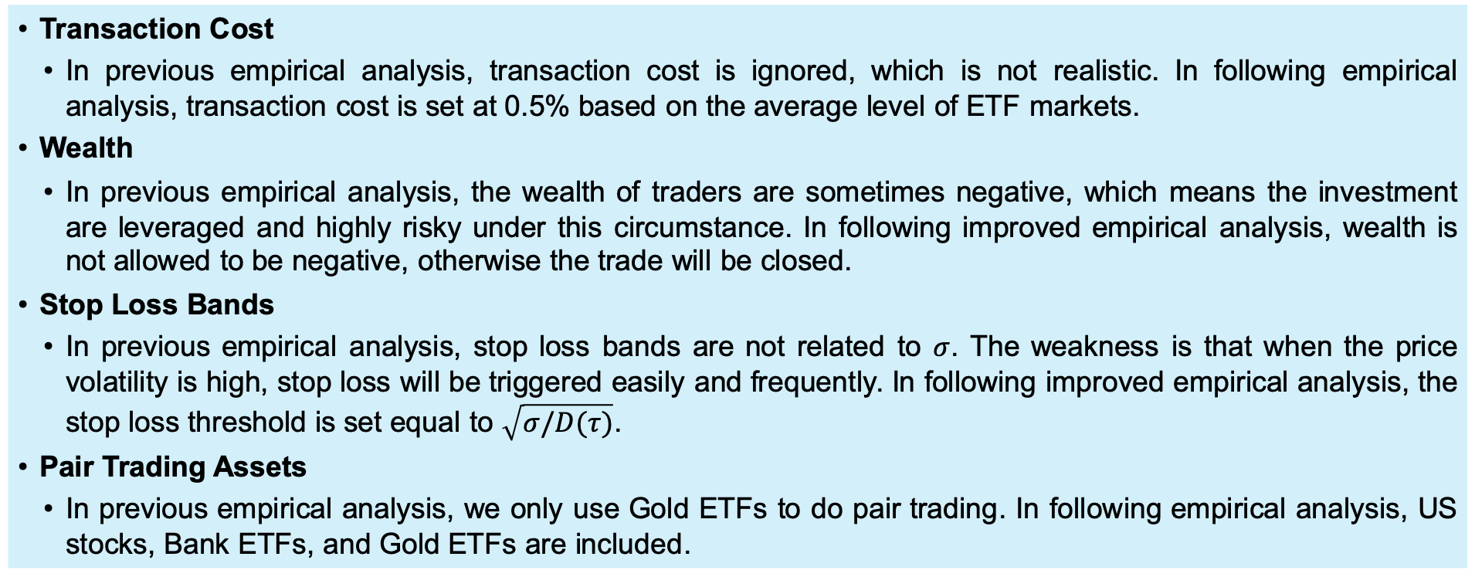
In this section, we improved previous empirical analysis in four ways: (1) transaction cost, (2) wealth, (3) the stop loss bands and (4) different pair trading assets.
Improvement
Transaction Cost
In previous empirical analysis, transaction cost is ignored, which is not realistic. In following empirical analysis, transaction cost is set at 0.5% based on the average level of ETF markets.
Wealth
In previous empirical analysis, the wealth of traders are sometimes negative, which means the investment are leveraged and highly risky under this circumstance. In following improved empirical analysis, wealth is not allowed to be negative, otherwise the trade will be closed.
Stop Loss Bands
In previous empirical analysis, stop loss bands are not related to $σ$. The weakness is that when the price volatility is high, stop loss will be triggered easily and frequently. In following improved empirical analysis, the stop loss threshold is set equal to $\sqrt{σ/D(τ)}$.
Pair Trading Assets
In previous empirical analysis, we only use Gold ETFs to do pair trading. In following empirical analysis, US stocks, Bank ETFs, and Gold ETFs are included.

Slide 26
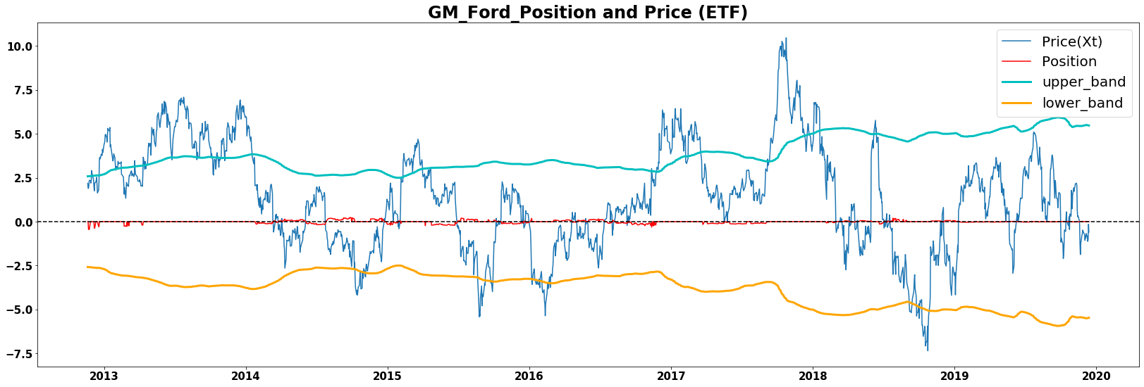
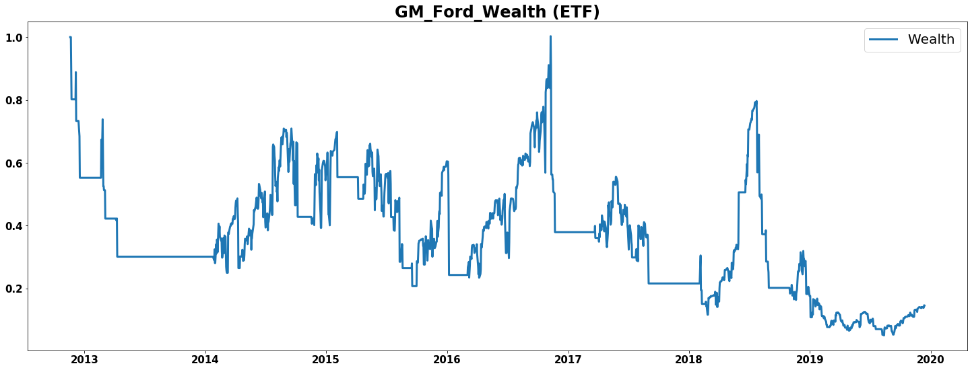
In this section, we look at two businesses that are highly correlated: GM and Ford. Since both are American auto manufacturers, the stock prices tend to move together.
US Stocks
Assets: Two US stocks (GM & Ford)

Slide 27
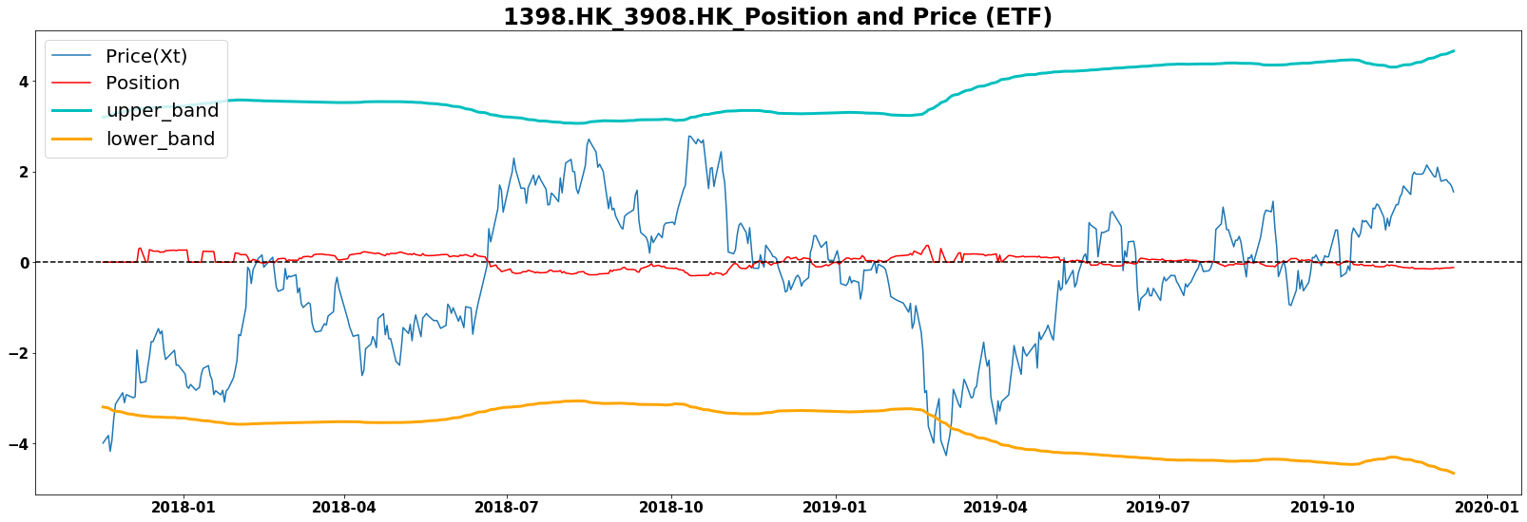
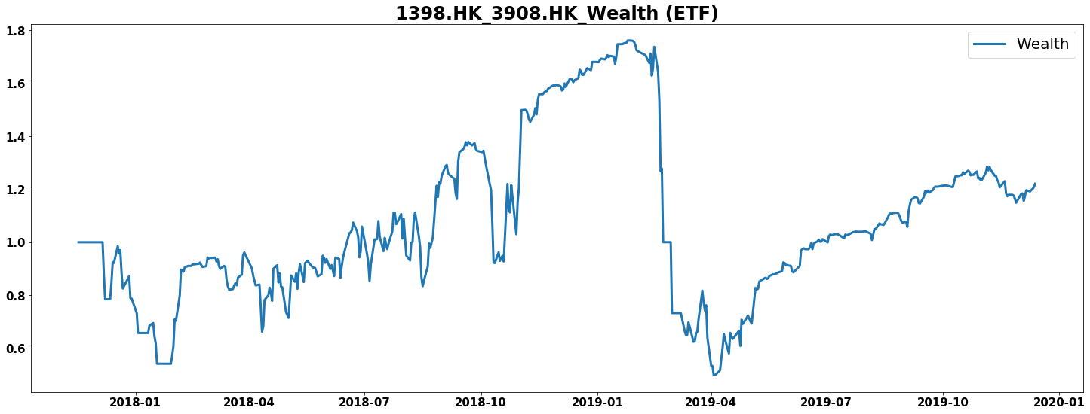
In this section, we look at two single stocks listed in Hong Kong. Since they both belong to bank-related industry, the prices of them tend to cointegrate.
Hong Kong Stocks
Assets: Two HK stocks (ICBC & CICC)

Slide 28
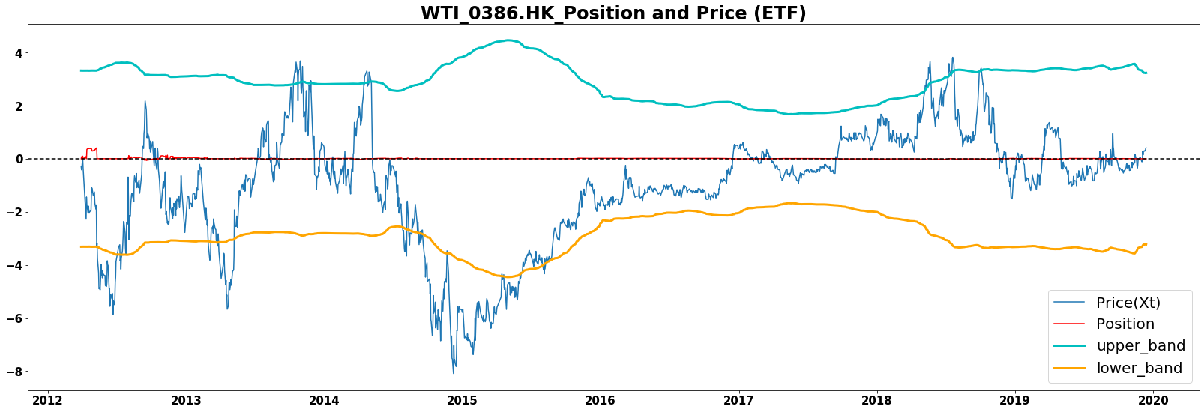
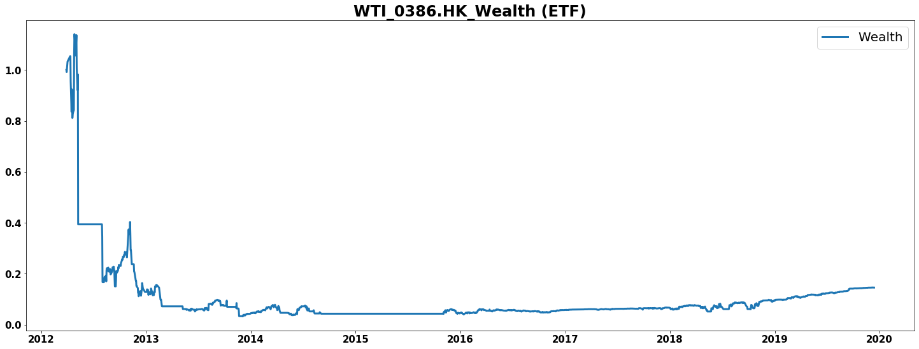
In this section, we look at WTI ETF and a Chinese oil and gas enterprise listed in Hong Kong – Sinopec. Since Sinopec’s stock performance is highly correlated with oil price, these two assets tend to move together.
ETF and Stock
Assets: ETF and Stock (WTI ETF & Sinopec)

Slide 29
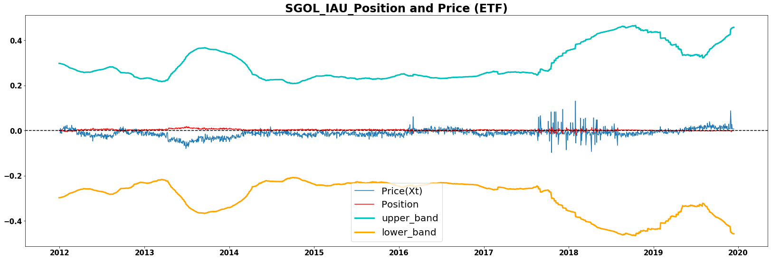
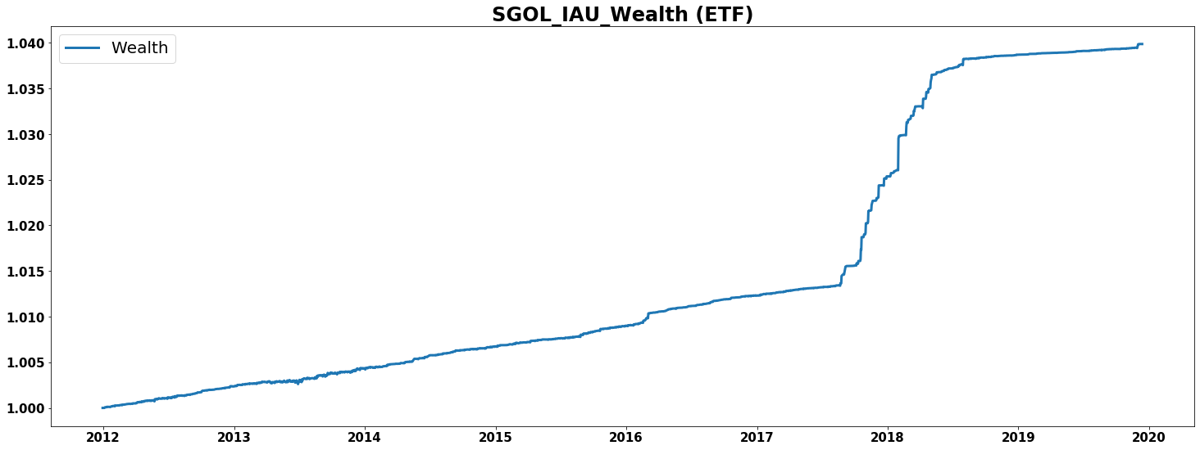
In this section, we focus on Gold ETFs showed in the previous slides again. This time, however, transaction rules have been updated in term of transaction cost, wealth and stop loss bands.
Commodities
Assets: Gold ETFs (IAU & SGOL)

Slide 30
In this section, we summarize the results of our updated empirical analysis.
Summary
1
Transaction Cost: The wealth goes down after including transaction cost while the trend of the wealth is similar.
2
Wealth: In all scenarios, the wealth in positive, so this change doesn’t show up in the result. However, if it is lower than zero, the trading would be stopped and the wealth would keep constant at zero.
3
Stop Loss Band: Obviously, the upper and lower bands are no longer smoothly, and they change with the volatility. Since the price features a time-varied volatility, we give it a time-varied band. When the volatility is high, the increasing band indicates the investors has a higher risk appetite.

Slide 31

Q & A
Thank You.

